Slide 1
Easterseals and Freddie Mac Present
Financial and Housing Guidance with CreditSmart®
October 19, 2017
Modules: 1, 2, and 3
Notes:
Financial education plays a significant role in our society. Understanding basic money management skills such as living within a budget and handling your credit and debt is very important.
Thank you for joining us for Easterseals and Freddie Mac’s presentation of Financial and Housing Guidance with CreditSmart.

Slide 2
Easterseals
Bridget Hayman
Bridget is an innovative communicator who specializes in digital, media, and content marketing. With 16 years experience activating successful cross-channel communication strategies in healthcare, finance and the nonprofit sector, she excels at engaging customers in meaningful ways to achieve business goals.
Currently the Director of Digital Marketing, PR and Brand Communications at Easterseals National in Chicago, Bridget provides day-to-day leadership for the digital content team responsible for Easterseals’ national website, SEO and SEM, national social media channels, email communications, and digital best practices for 75 local affiliates.

Slide 3
Freddie Mac’s CreditSmart®
Welcome to CreditSmart, Freddie Mac’s premier financial education curriculum, designed to help you learn how to build and maintain better credit, and prepare for successful long-term homeownership.
This curriculum will help you increase your financial knowledge by providing life-long money management skills. It provides:
Important information about credit and money management and how to avoid financial traps.
Insight into how lenders assess credit histories.
How credit plays a profound role in achieving your financial goal of buying a home and ensuring successful long-term homeownership.
Notes:
This curriculum is designed to help you increase your financial knowledge by providing life-long money management skills. In today’s presentation we will review:
Why is understanding your credit and money management is so important and how to avoid financial traps.
Insight into how lenders assess credit histories and finally,
How credit plays a profound role in every aspect of our lives, from buying and maintaining a home to buying auto insurance.

Slide 4
The Partnership
The Easterseals and Freddie Mac partnership is designed to help more people in the military, veteran and caregiving communities, as well as those with disabilities, obtain information on credit and financial management and affordable housing through renting or buying a home.
Notes:
The Esterseals/Freddie Mac partnership was created to help families serving in the military, veterans, caregivers and those with disabilities.
Our producer is Maheen Qureshi, Maheen….

Slide 5
Get to Know Your Producer
Maheen Qureshi
13+ years of experience in housing outreach, financial inclusion, and environmental finance
Worked at Freddie Mac for 10 years, managing national financial capability and foreclosure prevention initiatives
Developed the women’s financial capability initiative under CreditSmart and is committed to the economic empowerment of underserved communities
Multi-lingual; has lived in Pakistan, Myanmar, the Philippines, Indonesia and the U.S.
Served on the Board of SAALT, a national advocacy organization, for four years and participates in various mission-oriented leadership activities
Notes:
Thank you Bridget
My name is Maheen Qureshi and I’ll be your producer for today’s presentation.
13+ years of experience in housing outreach, financial inclusion, and environmental finance
Worked at Freddie Mac for 10 years, managing national financial capability and foreclosure prevention initiatives
Developed the women’s financial capability initiative under CreditSmart and is committed to the economic empowerment of underserved communities
Multi-lingual; has lived in Pakistan, Myanmar, the Philippines, Indonesia and the U.S.
Served on the Board of SAALT, a national advocacy organization, for four years and participates in various mission-oriented leadership activities

Slide 6
CreditSmart®
As part of this ongoing commitment, Freddie Mac developed a multilingual financial education curriculum and consumer outreach initiative designed to help consumers:
Build and maintain better credit.
Make sound financial decisions.
Understand the steps to sustainable homeownership.
Five different languages: English, Spanish, Chinese, Vietnamese and Korean
Notes:
As part of our ongoing commitment, Freddie Mac has developed CreditSmart, a multilingual financial education curriculum and consumer outreach initiative designed to help consumers build a better credit presence, make sound financial decisions and understand the steps to homeownership.
At this point I’ll turn the presentation over to our presenter Cora Fulmore.

Slide 7
Your Presenter: Cora R. Fulmore
Manager/Owner of the Mortgage & Credit Center, LLC
Creator of The Counselor’s Corner, Inc., an online training center for housing professionals, with more than 4,000 members
Co-organizer of the first Florida Housing Counselor Network, statewide
More than 35 years of experience in mortgage and credit counseling and training
National Consultant for many organizations, current faculty member of NeighborWorks since 1994; provides training in:
Certification for ED’s and Program Managers
Housing Counseling Certification
Foreclosure Prevention
Credit Counseling
CreditSmart® trainer since 2001
Notes:
Thanks Maheen and good afternoon to each of you. Thank you for joining us.
My name is Cora Fulmore, here’s a brief bio of my background.
I’ve been working in the industry for more than 35 years, providing direct consumer credit counseling services and training to industry professionals
I hope that you will find today’s content helpful and beneficial to you!

Slide 8
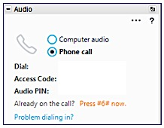
GoToWebinar Platform
Toll Number: 213-929-4232
Access Code: 631-904-067
Webinar ID: 370-579-235
A survey will pop up at the end of today’s webinar — please complete.
Your pop-up blocker must be disabled to view and complete the survey.
We appreciate your feedback!
Notes:
Please allow me to go over a few house keeping slides.
If you lose your connection or have difficulty with your audio, please use the callin number and access code shown here.
If you called in today, click on the “phone call” radio button.

Slide 9
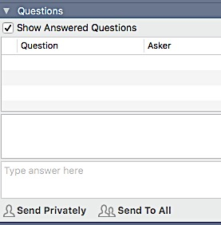
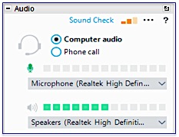
GoToWebinar Platform
Toll Number: 213-929-4232
Access Code: 631-904-067
Webinar ID: 370-579-235
A survey will pop up at the end of today’s webinar — please complete it.
Your pop-up blocker must be disabled to view and complete the survey.
We appreciate your feedback!
Notes:
If you’re using your computer speakers, please click on the “computer audio” radio button.
Below the audio section is the question box. Feel free to post your questions, statements and all answers in this box.
Maheen and Bridget will peruse the question box as we go through this class, so please if there are any questions, go to the question box to ask questions and share your thoughts.

Slide 10
GoToWebinar Platform
Toll Number: 213-929-4232
Access Code: 631-904-067
Webinar ID: 370-579-235
A survey will pop up at the end of today’s webinar — please complete it.
Your pop-up blocker must be disabled to view and complete the survey.
We appreciate your feedback!
Notes:
We’re sharing several handouts for today’s session. You can click on the presentation and other handouts within your dashboard to download and print so that you can make notes as we go. We will also e-mail this presentation along with several other handout within 24 hours of today’s session.
There are several helpful links that you’ll see throughout today’s presentation and at the end of the session that I’ll make available to you as I go through today’s presentation, you won’t be able to click on any links in this presentation while I’m displaying them, however, you will be able to click on all the links in the .pdf version of the documents that will be sent to later.
So let’s get started…

Slide 11
Rights and Responsibility
Rights
Responsibility
To control your personal money
To pay your bills and manage your money
Notes:
Managing your money is a personal skill that benefits you throughout your life – however this is not a skill that everybody has not learned.
Money comes in and goes out,
Our responsibility is to make sure that we’re making the right decisions about
Major purchases – are we paying too much
Our investments – Is the right person handling our money?
Our credit – do we truly understand what counts – have we looked at our credit report lately?
We know, it can be daunting – however this class is designed to start the conversation.

Slide 12
Rights and Responsibility
Rights
Responsibility
To have a job and make money
To keep a job, so you can live the way you want to
Notes:
We all have the right to make money.
And we also have the responsibility to know and understand our rights under the law.
To know and understand the consumer protection laws that protects the rights and responsibilities of all Americans.

Slide 13
Rights and Responsibility
Rights
Responsibility
To keep things of your own
To take care of your things
Notes:
With all rights, comes responsibility.
As we present this information, think of questions that you might have around personal finance, money management and/or credit.
This is your opportunity to pose your questions and we will attempt to address all questions regarding your rights and responsibility to being a wise steward of the money that you have been entrusted to manage and used.

Slide 14
Rights and Responsibility
Rights
Responsibility
To have privacy, spend time alone to talk to whom you want to privately
To speak up when you want to be alone
Notes:
As we go through today’s webinar we will discuss your right to privacy of your information.
And the responsibility of those who provide services to you.

Slide 15
Rights and Responsibility
Rights
Responsibility
To stay up-to-date on news and current events
To know what’s going on in the world around you
Notes:
You have the rights and responsibility to stay up-to-date of news and current events as it relates to your financial affairs.
That’s why we bring to you CreditSmart.
So before we get started, what’s the latest hot topic centered around credit that has bombarded the news in the last 30 days?
Go to your question box and tell us what you think.
The Equifax information breach.

Slide 16
Notes:
So let’s get started…
Good credit helps you realize your dreams. From buying a home, a car, leasing an apartment or getting a job — all these events may require a credit check.
Perhaps you want to make a major purchase with credit, such as a new computer or an appliance for your home? Or perhaps you want a loan so you can go to college or send your children to school?
These are important life events and can be made easier if you have good credit.

Slide 17
Financial Wellness – Building a Better Financial Future
Financial wellness is a hot topic that includes not only understanding how to manage money but also how to make wise financial decisions that can improve your overall well-being.
Your disability benefit, just like other types of money, checks, or payments comes with little guidance on how best to manage your finances.
Notes:
Financial wellness is a hot topic that includes not only understanding how to manage your money but also how to make wise financial decisions that can improve your overall well-being.
The money that we get to spend usually comes with little to no guidance or instructions.
Regardless of the source, your income – my income must be managed.
Later we’ll talk about the sources of income and there are many.

Slide 18
Why is CreditSmart® Important?
We talk about money and credit constantly, however we rarely discuss this important topic with professionals.
We owe it to ourselves to get a better understanding of credit and how to safeguard our financial future.
Remember: What you don’t understand about credit can harm you!
Notes:
We owe it to ourselves to get a better understanding of credit and how to safeguard our financial future.
Remember: What you don’t understand about credit and/or money management can harm you!
Credit is the ability to borrow tomorrow’s money to pay for something you get today, such as a home, furniture or car. It is a promise to repay a debt, and how you’ve managed your credit is a reflection on your credit reputation.

Slide 19
What is Credit?
Credit is the ability to borrow money.
Credit is extended through several means, including credit cards, personal car loans, and home mortgages.
Credit is a privilege, not a right.
To increase confidence of lenders and to improve our chances of obtaining credit at reasonable terms, we need to determine our financial stability and security.
Notes:
Credit means receiving something of value now and promising to pay for it later, often with finance charges and sometimes other fees being added.
So, count the cost of credit before taking on new debt.
It’s simple, credit is a privilege, not a right.
Credit is extended through several means, including credit cards, personal car loans, and home mortgages.
TRUTH: Unfortunately, many of us struggle to control our use of credit and get overwhelmed by bills.
We will share some helpful tools you can use to help you manage your money.

Slide 20
Knowledge Checkpoint – Poll Question #1
How can having good credit benefit you?
In buying a home and/or renting an apartment
Buying insurance
Getting a job.
All of the above
Now of the above
Notes:
Here’s a quick poll question.
I will launch the poll and please respond to the poll not in the question box.
If you answered ALL OF THE ABOVE, you are absolutely correct

Slide 21
Poll Question #2
Do you know your creditworthiness?
YES
NO
Notes:
Now this is a difficult question, but I ask this question to make you think about your credit position.
Do you know your creditworthiness? Yes or No
Your creditworthiness takes into consideration factors like your income, financial commitment, employment status, types of accounts, length of payment history and your ability to repay debt. You should know the value of your credit standing before applying for credit. Knowing your creditworthiness value, will help you to determine if the loan you’re being offered is predatory.
A predatory loans have higher interests and additional fees. The terms & conditions of your loan might not also be favorable.
A predatory loan is often referred to as a “B” or “C” loans.

Slide 22
We are Surrounded by Opportunities to Spend
The most important component of your credit report is whether you make your payments on time.
Notes:
We are all Surrounded by Opportunities to Spend Money.
Remember: Avoid overspending, excessive fees and hidden costs. Know the terms and conditions of the contract before you sign on the dotted lines.
Avoid expensive late fees. Make all payments before the due date to avoid the risk of missing the payment cutoff date and always strive to pay more than just the minimum payment.

Slide 23
“How Did You Learn About Money?”
Poll Question #3
On Your Own
Media
Family/Friends
Hard Knocks
Co-workers
Notes:
So, here’s another poll question for you:
“How Did You Learn About Money?” Please allow me to launch the poll:
On Your Own
Media
Family/Friends
Hard Knocks
Co-workers
We have all learned differently☺

Slide 24
Your Credit History
Your credit history shows how you have managed your finances and repaid your debts over time.
Your personal credit report begins the first time you apply for credit.
The most important component of your credit report is whether you make your payments on time.
www.annualcreditreport.com
Notes:
Remember:
Your credit history shows how you have managed your debts in the past.
It begins the first time you apply for credit.
The most important component of your credit history is whether you’ve made your payments on time.
If you have not seen a copy of your credit report, you can by going to www.annualcreditreport.com there you can receive 1 free copy of your credit report from each bureau, per year.

Slide 25
Poor Credit Can COST YOU
TERMS YOU SHOULD KNOW
“A” Loans | An "A" loan is the credit industry term used to describe a loan that reflects the best possible interest rate, terms, and conditions. Consumers need to demonstrate good credit in order to secure an "A" loan.
“B” or “C” Loans | A "B" or "C" loan is the credit industry term used to describe a loan that reflects less than the best possible interest rate, terms, and conditions. Consumers with negative or derogatory credit may be offered "B" or "C" loans. These loans always impose a higher interest rate and fees.
Creditors | Creditor is the term used for the person or entity that is providing credit or a loan to a borrower at specific terms and conditions. The term creditor can generally be used interchangeably with the term lender.
Notes:
Here are a couple of important terms you should know for this module:
”A’ paper loan – loan that reflects the best possible interest rate, terms, and conditions.
“B” or “C” paper loans – Loans that’s offered to consumers with negative or derogatory credit. These loans always impose a higher interest rate and fees.
Creditor is the term used for the person or entity that’s providing credit to the consumer.

Slide 26
Managing YOUR INCOME is IMPORTANT
Notes:
There are two very important reasons to manage your income.
First, you need to know how much you earn, this will help you to know how much you can afford to spend and save.
We’ll talk more about creating a spending and saving’s plan later in this module.
First, let’s start by looking at the various sources of income.

Slide 27
Social Security Disability Income
Most SSDI recipients receive between $700 and $1,700 per month (the average for 2017 is $1,171). However, if you are receiving disability payments from other sources, your payment may be reduced.
According to the U.S. Bureau of Labor Statistics, more than five million people with disabilities were employed in 2015.
17.5 percent of people with a disability employed in 2015
Notes:
First Social Security Disability Income
There are many factors that can impact your income from social security.
Most SSDI recipients receive between $700 and $1,700 per month (According to the Bureau of Labor Statistics the average for 2017 is $1,171).

Slide 28
Veterans Compensation Benefits Rate Tables - Effective 12/1/16
30% - 60% Without Children
70% - 100% Without Children
Dependent Status | 30% | 40% | 50% | 60%
Veteran Alone | $408.97 | $589.12 | $838.64 | $1,062.27
Veteran with Spouse Only | $456.97 | $654.12 | $919.64 | $1,159.27
Veteran with Spouse and One Parent | $495.97 | $706.12 | $984.64 | $1,237.27
Veteran with Spouse and Two Parents | $534.97 | $758.12 | $1,049.64 | $1,315.27
Veteran with One Parent | $447.97 | $641.12 | $903.64 | $1,140.27
Veteran with Two Parents | $486.97 | $693.12 | $968.64 | $1,218.27
Additional for A/A spouse (see footnote b) | $45.00 | $59.00 | $74.00 | $89.00
Dependent Status | 70% | 80% | 90% | 100%
Veteran Alone | $1,338.71 | $1,556.13 | $1,748.71 | $2,915.55
Veteran with Spouse Only | $1,451.71 | $1,686.13 | $1,894.71 | $3,078.11
Veteran with Spouse and One Parent | $1,542.71 | $1,790.13 | $2,011.71 | $3,208.56
Veteran with Spouse and Two Parents | $1,633.71 | $1,894.13 | $2,128.71 | $3,339.01
Veteran with One Parent | $1,429.71 | $1,660.13 | $1,865.71 | $3,046.00
Veteran with Two Parents | $1,520.71 | $1,764.13 | $1,982.71 | $3,176.45
Additional for A/A spouse (see footnote b) | $105.00 | $119.00 | $134.00 | $149.08
http://www.benefits.va.gov/compensation/resources_comp01.asp
Notes:
Veterans Compensation
The amount of basic benefits depends on the level of your disability. VA makes the determination based on the severity of your disability. VA rates disability from 0% to 100% in 10% increments.
VA calculates disability percentage for multiple disabilities:
loss of limb(s)
you have a spouse or children
And even dependent parent
For more information, please checkout the link that we’ve provided here at the bottom of this slide.

Slide 29
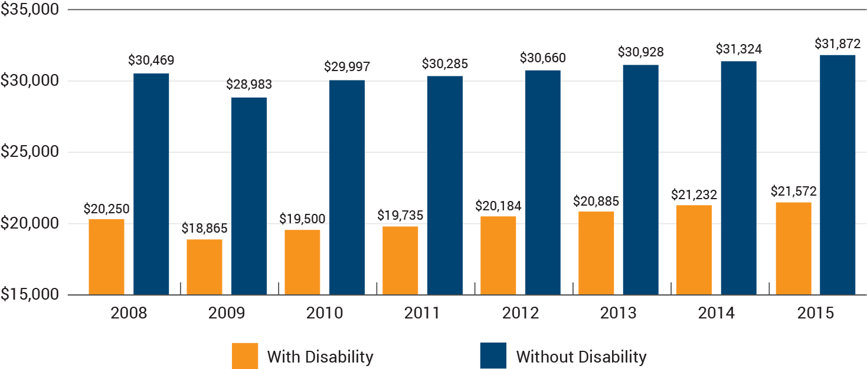
Employment Income With and Without Disabilities
Median Earnings, Ages 16 and Over, 2008-2015
https://disabilitycompendium.org/sites/default/files/user-uploads/2016_AnnualReport.pdf
Notes:
There’s also Employment Income for individuals With and Without Disabilities.
What I dislike the most is the disparity we see in this chart among those w/wo disabilities.
Now there are many reasons for this disparity, to get more information, please see the study that was done by the University of New Hampshire.
I’ve provided the link to this study at the bottom of this slide.

Slide 30
Sources of Income for Older Adults
Social Security: 85 percent of people 65 and older get Social Security. The average Social Security income in 2017 will be $1,360, according Social Security Administration.
Assets: 63 percent of retirees rely on assets for retirement income. According to Retirement USA, “the median amount of asset income is $1,542 for those households who received any asset income.”
Pensions: Only 32 percent of today’s retirees have pensions and this number is trending further downward.
Earnings: 23 percent of older Americans have work income. According to the AARP, the median retirement income earned by retirees from work is $25,000 a year.
Public Assistance or Veteran’s Benefits: About 7 percent of retirees are getting help from government sources.
https://www.newretirement.com/retirement/average-retirement-income-2017/
Notes:
Here’s some basic FACTS about older adults and their income:
Social Security: 85 percent of people 65 and older get Social Security.
Assets: 63 percent of retirees rely on assets for retirement income.
Pensions: Only 32 percent of today’s retirees have pensions and this number is trending further downward.
Earnings: 23 percent of older Americans have work income. The median retirement income earned by retirees from work is $25,000 a year.
Public Assistance or Veteran’s Benefits: About 7 percent of retirees are getting help from government sources.
So what if the money you have, is being managed by a Caregiver or the money coming into the household is being generated by the Caregiver.
Let’s talk a look at the next few slides to see the costs associated with being a Caregiver.

Slide 31
Role of the Caregiver
Notes:
We know the role of the Caregiver is to Support, Learn and Grow.
Based on a AARP Study, family caregivers spent on average just under $7,000 in 2016, 20% of their income, on caregiving expenses.

Slide 32
Caregiving Cost Study | November 2016
Costs associated with being a Caregiver usually falls in one of five categories:
Medical expenses
Additional household expenses
Personal care item expenses
Educational, legal and other expenses
Caregiver personal expenses/Respite
http://www.aarp.org/content/dam/aarp/research/surveys_statistics/ltc/2016/family-caregiving-cost-survey-res-ltc.pdf
Notes:
So there are many costs associated with being a Caregiver; usually the cost falls in one of five categories:
Medical/Dental/Vision expenses
Additional household expenses
Personal care item expenses
Educational, legal, travel, and other expenses
Caregiver personal expenses/Respite (Aides, adult day services, self-care, other paid help, and other expenses)
The link below provides a complete copy of the AARP study on caregivers.

Slide 33
Are There Any Other Hidden Costs?
Notes:
So, are there any other hidden costs?
If so go to the question box.

Slide 34
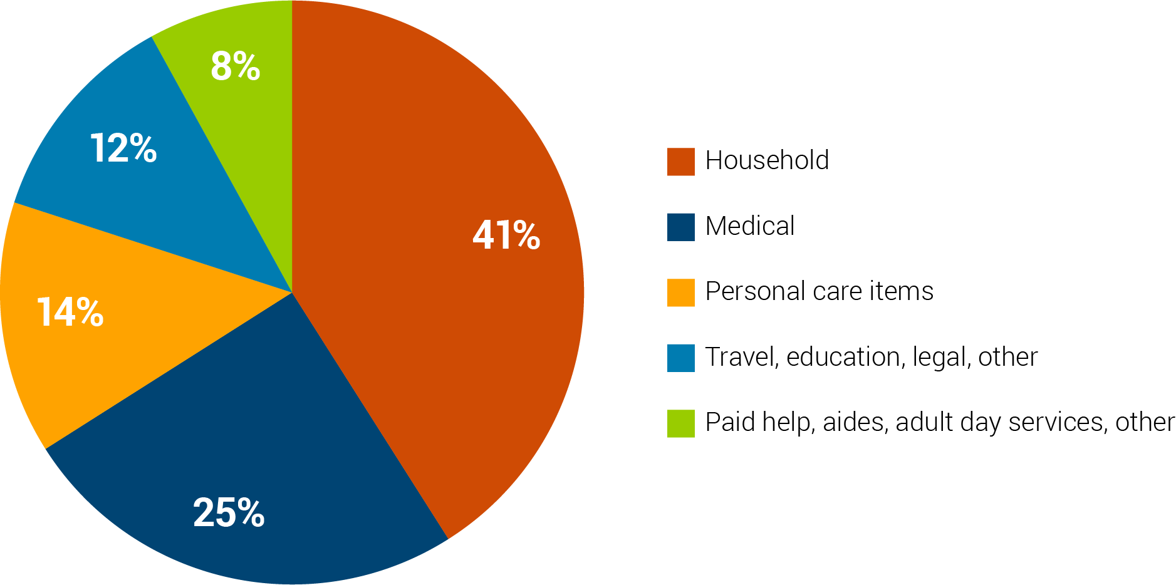
Percentage of Out-of-Pocket Costs of a Caregiver
Source: AARP http://www.aarp.org/caregivercosts
Notes:
This chart provides a great depiction of the out of pocket costs and where the money goes.

Slide 35
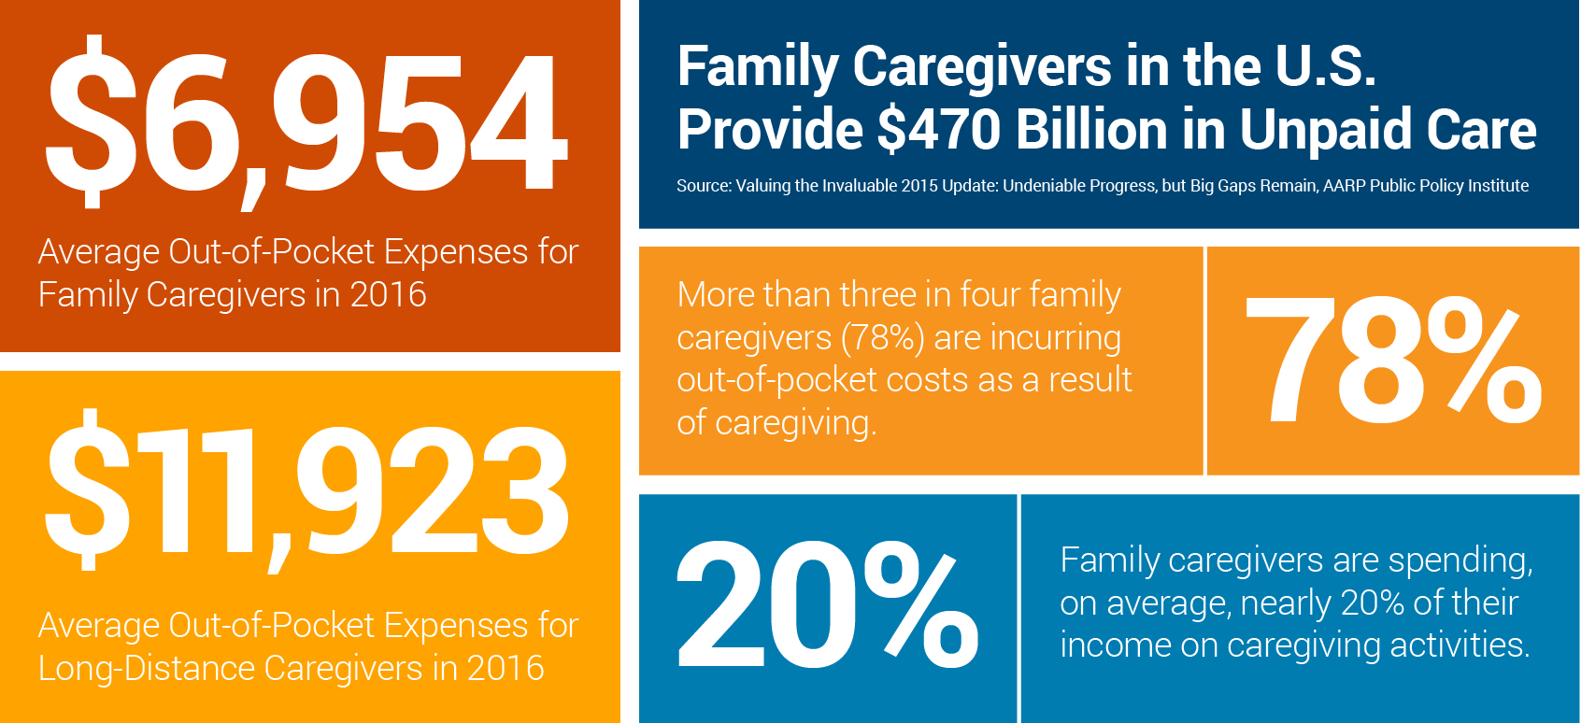
The AARP Survey
REPORT SPOTLIGHTS FINANCIAL TOLL OF FAMILY CAREGIVING
Credit for Caring Act Could Help
SOURCE: Family Caregiving and Out-of-Pocket Costs: 2016 Report (http://www.aarp.org/caregivercosts)
Notes:
THIS CHART PROVIDES A GOOD VISUAL OF THE AVERAGE AMOUNT SPENT AND PERCENTAGE.

Slide 36
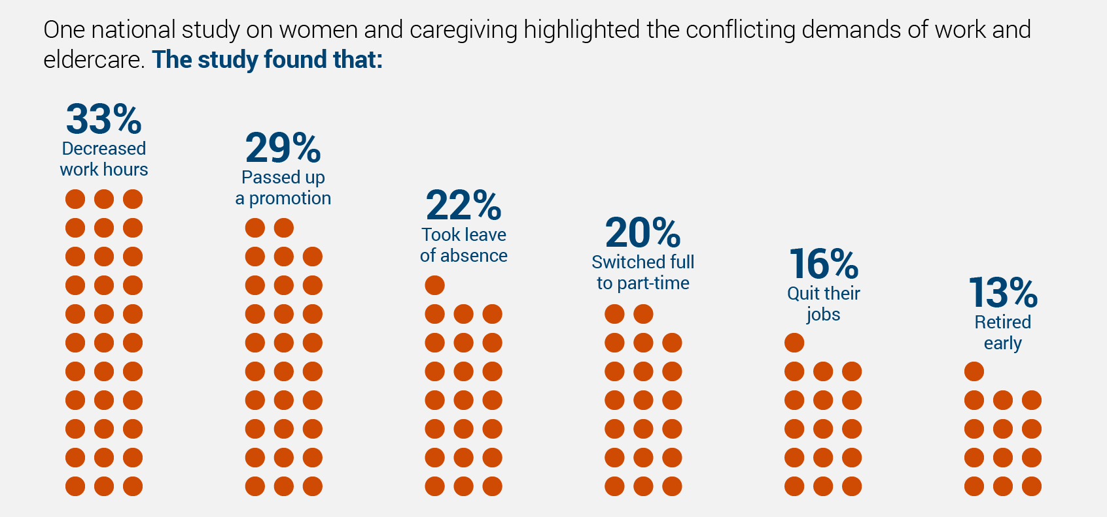
Demands of Work and Care
Notes:
There are other demands on the caregiver that impacts income. This chart shows how the working caregiver’s work hours, opportunity for promotion, absenteeism and retirement is often challenged.
This reinforces the reason why creating a spending and savings plan is so important.

Slide 37
Caregiver: Take Care of Yourself
It is critical to maintain your own life, complete with social, physical and emotional interactions. You need it and deserve it. When you are at your best, you will be more effective in carrying out your caregiving responsibilities.
Notes:
So, for the Caregivers on this call: Please Take Care of Yourself
It is critical to maintain your own life, complete with social, physical and emotional interactions.
When you’re at your best, you will be more effective in carrying out your caregiving responsibilities.

Slide 38
Be Aware of the Signs That You May Need More Help
Excessive use of alcohol, medications or sleeping pills.
Appetite changes — either eating too much or too little.
Depression — hopelessness, feelings of being alone, lack of energy to do new things.
Increased irritability.
Trouble falling or staying asleep.
Chronic fatigue.
Difficulty concentrating or missing appointments.
Physical symptoms such as continual headaches, backaches, or stomach pain.
Notes:
Be Aware of the Signs That You May Need More Help

Slide 39
Caregiving: A Big Responsibility
Caregiving expense category figures by race/ethnicity
Expense Category | All Caregivers | White | African American | Hispanic/Latino | Asian
Sum of all expenses | $6,954 | $6,964 | $6,616 | $9,022 | $2,935
Medical expenses | $1,722 | $2,072 | $1,041 | $1,093 | $650
Household expenses | $2,854 | $2,894 | $2,097 | $3,846 | $908
Personal care item expenses | $961 | $967 | $495 | $1,547 | $262
Education, legal/travel expenses | $830 | $541 | $1,828 | $1,753 | $769
Caregiver personal expenses/respite (Aides, adult day services, self-care, other paid help, and other expenses) | $587 | $490 | $1,156 | $783 | $346
Sum of expenses as a percentage of annual income | 20% | 14% | 34% | 44% | 9%
Note: disproportionate spending would be a percentage exceeding that of the “Sum” column for each expense category.
SOURCE: Family Caregiving and Out-of-Pocket Costs: 2016 Report (http://www.aarp.org/caregivercosts)
Notes:
Understand your responsibilities, they’re not all financial.
This chart shows the caregiving costs based on ethnic background.

Slide 40
Managing Your Money is IMPORTANT!
Managing your money well is a problem for many people. For people living with disabilities, however small or large, financial situations can become even more complicated. Substantial medical bills coupled with a limited income can make money management extremely challenging.
Although financial pressures can be stressful, there are ways to get a handle on your finances and reclaim your financial independence.
Notes:
Managing your money well is a problem for many people.
For people living with disabilities - however small or large, financial situations can become even more complicated. Large medical bills coupled with a limited income can make money management extremely challenging.
Although financial pressures can be stressful, there are ways to get a handle on your finances and reclaim your financial independence.

Slide 41
Agree (A), Disagree (D) or Unsure (US)
A representative payee should be given full Power of Attorney of all your bank accounts.
It is very important that you plan how much you are going to spend each week.
Everyone should obtain a copy of their credit report every year.
Notes:
So, how can we be proactive?
Quick activity – Agree, Disagree or Unsure
Respond in the question box.

Slide 42
Steps to Gaining Control of Your Finances:
Build a strategy and stick to it.
Understand your finances.
Seek professional counsel.
Notes:
Here are the steps to gaining better control of your finances:
Build a strategy and stick to it.
Understand your finances.
Seek professional counsel.

Slide 43
Step 1: Know Your Income
Are you able to work and generate additional income?
Make sure you know exactly how much money you expect to get and when you expect to get it. If you receive regular checks from the government or an employer, you should know what to expect.
If your hours and pay vary from week-to-week or you are self-employed, you should project an average set of wages.
Notes:
STEP 1 – Know your Income
Are you able to work to generate additional income?
Do you know exactly how much money you can expect to get and when you expect to get it?
If your hours and/or pay varies, what’s your projected income?

Slide 44
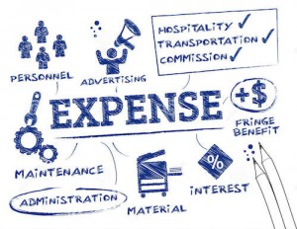
Step 2: Know Your Regular Expenses
These expenses might include:
Rent or mortgage
Utilities (telephone, cable, Internet, power, water, trash)
Groceries
Insurance
Medications
Transportation costs
Medical costs not covered by insurance
Entertainment and leisure costs
Personal costs; special medical devices
Any debt repayments
Notes:
Step 2: Know Your Regular Monthly Expenses; here are a few…

Slide 45
Step 3: Create a Spending Plan and Saving Plan
A spending plan serves as a good guideline. Get an accurate picture of your income and expenses:
Keep a daily log by writing down every item you purchase and any bills that are paid by cash, check or electronic transfer.
Design a spending plan that works for you. For some categories, such as rent or mortgage payment, you know exactly what the amount is. For others, you can estimate an amount either based on analysis of your daily log or past experience.
After you know your expenses, you’ll be able to start designing your savings plan.
Notes:
Step 3: Create a Spending and Saving Plan
This should be easy, just keep a daily log of what you spend money on.
Design a spending plan that works for you. Each person spends differently – I’ve attached a sample budget form that will be sent out to you as a handout, there’s also lots of online tools that you can use.
After you develop the spending plan, then it’s time to set up a saving’s plan.

Slide 46
How to Save: Creating a Savings Plan
Once you have regained control of your day-to-day expenses, you might want to consider a savings plan. If you are a recipient of Social Security benefits or Medicaid, you should always make sure to ask how much you can save without violating the conditions of your arrangement.
Save a little at a time
Open a different bank account
Decorate a piggy bank
Bargain with yourself
Hold on to unexpected windfalls
Save through your employer
Notes:
You must first regain control of your day to day expenses. Then:
Save a little at a time
Open a different bank account
Bargain with yourself
Hold on to unexpected windfalls
Consider saving through your employer
REMEMBER: If you are a recipient of Social Security benefits or Medicaid, you should always make sure to ask how much you can save without violating the conditions of your eligibility for the program that you’re under.

Slide 47
ABLE Account
ABLE Accounts were created out of the Achieving a Better Life Experience Act of 2014 so that Americans with disabilities and their families can build savings. Contributions of post-taxed dollars can be made by anyone including the beneficiary, family, and friends.
While the contributions are not tax deductible, withdrawals and investment income earned from ABLE accounts will not be taxed.
The ABLE National Resource Center (ANRC) is a collaborative whose supporters share the goal of accelerating the design and availability of ABLE accounts for the benefit of individuals with disabilities and their families.
www.http://ablenrc.org
Notes:
HERE’S ANOTHER SAVINGS TOOL CALL ABLE ACT.
ABLE Account was created out of the Achieving a Better Life Experience Act of 2014 so that Americans with disabilities and their families can build savings.
What’s great about this program; is that earnings from this account will not be taxed, and will not be considered as income for (SSI), Medicaid, and other federal means-tested benefits.
There is an age requirement: You must be or your child must be disabled before the age 26.
Total annual contributions may not exceed the federal gift tax contribution, which is currently $14,000 (this will periodically be adjusted for inflation).
Here’s a great resource: The ABLE National Resource Center (ANRC); it’s a collaboration of supporters who share the goal of accelerating the design and availability of ABLE accounts for the benefit of individuals with disabilities and their families.

Slide 48
6 Things You Should Know:
You can open an ABLE account, no matter where you live.
Anyone can contribute to an ABLE account, but there are financial limits.
ABLE accounts will not impact your eligibility for benefits.
ABLE account funds can be used for any expense related to living with a disability.
Not all Americans with a disability are eligible for ABLE accounts.
Not all institutions offer the ABLE account
Notes:
You can open an ABLE account, no matter where you live.
Total annual contributions may not exceed the federal gift tax contribution, which is currently $14,000 (this will periodically be adjusted for inflation).
Not being provided through most banks.
This type of account is tied to the stock market and other systems.
Not all Americans with a disability are eligible for ABLE accounts.
Anyone can contribute to an ABLE account, but there are financial limits.

Slide 49
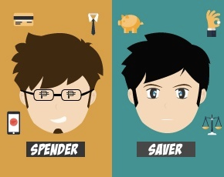
“What Type of Spender Are You?”
Poll Question #4
Impulsive — These individuals buy items without planning their purchase and often buy things they don’t need.
Passive — These individuals don’t like to shop and usually buy items without comparing prices or asking questions.
Esteem — These individuals shop for things that they think will impress others, boosting their image and esteem.
Avoidance — These individuals shop to avoid/ escape dealing with the stresses of daily life.
Recreational — These individuals shop to kill time.
Notes:
Here’s an activity☺

Slide 50
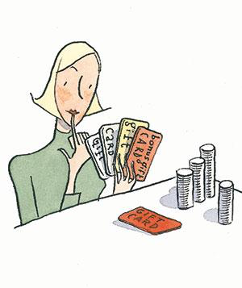
Get Help
If you are having a difficult time managing your money despite efforts to track and regulate your spending, you may want to consider asking a trusted family member, friend or professional to assist you with your finances. There are several ways you can do this.
Notes:
If you are having a difficult time managing your money despite efforts to track and regulate your spending, you may want to ASK FOR HELP.
Consider asking a trusted family member, friend or professional to assist you with your finances.
There are several ways you can do this, but be careful. It should be someone you trust.

Slide 51
Get Help
Informal mentoring by others — Friends, family, and volunteers may help you manage your finances. Schedule a regular meeting to have someone come over and help you look at your finances and see whether you have been spending well.
Notes:
THERE ARE SEVERAL WAYS TO DO THIS:
Informal mentoring
Friends, family, and volunteers can help you manage your finances.
Schedule monthly meetings to have someone go over your finances with you to see if you are on target with your finances.

Slide 52
Get Help
Mentoring or assisting programs — One of the easiest ways to get help with your finances is to join a mentoring or financial assistance program. If you are part of a financial institution, there may be advisors on staff who can help you manage your money. Local nonprofits might also offer training.
Notes:
Mentoring programs
One of the easiest ways to get help with your finances is to join a mentoring or financial assistance program.
If you are part of a financial institution, there may be advisors on staff who can help you.
Local nonprofits might also offer training.

Slide 53
Get Help
Power of Attorney — If you are unable to manage your affairs because of your condition, you can give other people the ability to exercise some or all of your actions in your name, including financial actions, through a power of attorney. A power of attorney is a legal document and needs to be notarized. The more specific and limited a power of attorney is, the better.
For example:
A good power of attorney might authorize Jane Doe to make withdrawals from your bank account to pay your utility and rent or mortgage bills only.
A more broad power of attorney allowing Jane Doe to make withdrawals from your bank account could cause more problems.
Notes:
Power of Attorney
If you are unable to manage your affairs because of your condition, you can a power of attorney.
This person would have the ability to exercise some or all of your actions in your name, including financial action.
A power of attorney is a legal document and needs to be notarized.
A more specific and limited a power of attorney is, the best.

Slide 54
Get Help
Representative Payee — If you are receiving disability income from the Social Security Administration and you are a minor or cannot manage your money, you may be assigned a representative payee.
The representative payee, which could be a person or an organization, will receive your check and spend it on your behalf.
The payee must spend the money for your benefit, save any unspent money for you, and make reports to the Social Security Administration.
Unless they have been appointed as your guardian, the representative payee does not have a power of attorney to conduct legal transactions for you.
You can read more about rep payees at http://www.ssa.gov/payee/faqrep.htm.
Notes:
Representative Payee
If you are receiving disability income from the Social Security Administration and you are a minor or cannot manage your money, you may be assigned a representative payee.
The representative payee, which could be a person or an organization, will receive your check and spend it on your behalf.
The payee must spend the money for your benefit, save any unspent money for you, and make reports to the Social Security Administration.
Unless they have been appointed as your guardian, the representative payee does not have a power of attorney to conduct legal transactions for you.
You can read more about rep payees at http://www.ssa.gov/payee/faqrep.htm.
I’ve also provided you with a really good document for additional information.

Slide 55
CAUTION, CAUTION, CAUTION
Always enter any relationship with extreme caution.
Turning over your financial information will give another person access to your information - what you've bought, where you've been.
Once you turn over financial decision-making power or authority to another person either willingly or as part of a prescribed plan, you may have a very difficult time getting it back.
You should not turn over decision-making power to anyone who could profit by you, such as a landlord who owns the place you rent or a doctor who is in charge of arranging appointments.
If someone spends your money on something you don't want, you may have a hard time proving that fact.
Notes:
CAUTION, CAUTION, CAUTION
Always enter any relationship with extreme caution.
Turning over your financial information will give another person access to your information - what you've bought, where you've been.
Once you turn over financial decision-making power or authority to another person either willingly or as part of a prescribed plan, you may have a very difficult time getting it back.
You should not turn over decision-making power to anyone who could profit from you, such as a landlord who owns the place you rent or a doctor who is in charge of arranging appointments.
If someone spends your money on something you don't want, you may have a hard time proving that fact.

Slide 56
Notes:
So it’s all about understanding the difference between WANTS –vs- NEEDS

Slide 57
Managing Your Money
Savings is key to good money management.
Knowing the difference between a need and want is important.
A “need” is something that is required for basic survival (e.g., shelter, food, clothing).
A “want” is something that is not essential for survival, but is desired for comfort, convenience, or status.
A spending plan is an itemized list of all of your expenses and is used to measure or gauge your expenses against your income.
Notes:
Savings is key to good money management.
Knowing the difference between a need and want is important.
A “need” is something that is required for basic survival (e.g., shelter, food, clothing).
A “want” is something that is not essential for survival, but is desired for comfort, convenience, or status.
A spending plan is an itemized list of all of your expenses and is used to measure or gauge your expenses against your income.

Slide 58
Useful Resources
TERMS YOU SHOULD KNOW
Credit Counseling | Look in your community to locate nonprofit credit counseling agencies that can offer you free or low-cost assistance to get back on track. Contact the National Foundation for Credit Counseling (www.nfcc.org), which includes more than 700 community-based offices located in all 50 states and Puerto Rico. To locate a National Foundation for Credit Counseling Member Agency in your area, call: 800-388-2227.
Credit Repair Companies | Credit repair companies are private, for-profit businesses that claim to offer consumers with credit and debt repayment difficulties assistance in “fixing” their credit problems and/or “fixing” an impaired credit report.
Notes:
HERE ARE SOME TERMS YOU SHOULD KNOW.

Slide 59
Goal Setting is IMPORTANT to Every Budget
Notes:
Financial planning helps you determine your short and long-term financial goals and create a balanced plan to meet those goals.
This is a short module, however very powerful.

Slide 60
Where Do I START?
Managing your finances will be less difficult if you set goals and remain focused on attaining them.
Writing down your goals and the timeframe for achieving them is an important step in moving toward making them come true.
Goals will change based on time, situations and/or events.
Notes:
WHERE DO YOU START?
Managing your finances will be less difficult if you set goals and remain focused on attaining them.
Writing down your goals and the timeframe for achieving them is an important step in moving toward making them come true.
Goals will change based on time, situations and/or events.

Slide 61
Goals Can CHANGE
What are your short-term and long-term goals?
What plans do you have in place to achieve these goals?
How often do your goals change?
Have you had a goal that you were not able to achieve?
If so, why? Why is it important to write down your goals?
Notes:
REMEMBER THAT: Goals Can CHANGE
What are your short-term and long-term financial goals?
What plans do you have in place to achieve these goals?
How often do your goals change?
Have you had a goal that you were not able to achieve?
If so, why? Why is it important to write down your goals?

Slide 62
Our Definition of GOALS
Short-term goals can be achieved in six months or less.
Medium-term goals can be achieved in seven months to one year.
Long-term goals can be achieved in more than one year.
When setting goals, decide which goals are most important and assign each goal a priority.
Notes:
Here’s Our Definition of GOALS
Short-term goals can be achieved in six months or less.
Medium-term goals can be achieved in seven months to one year.
Long-term goals can be achieved in more than one year.

Slide 63
Chat Question
What are some examples of life changes you may experience that may have an impact on achieving your goals?

Slide 64
We All Have Life Challenges…
Remember:
Always be prepared to reexamine your goals. Your goals and priorities will change over time.
Always take the time to ask yourself, if you are on target with your stated goals. If not, refocus, adjust, if necessary start all over again. It’s okay!
Notes:
Remember:
Always be prepared to reexamine your goals. Your goals and priorities will change over time.
Always take the time to ask yourself, if you are on target with your stated goals. If not, refocus, adjust, if necessary start all over again. It’s okay!

Slide 65
Resources
For Information and technical assistance on the Americans with Disabilities Act | https://www.ada.gov
Helpwithmybank.gov helps you find answers to your questions regarding national banks and federal savings associations. | https://www.helpwithmybank.gov/index.html
Consumer Financial Protection Bureau | https://www.consumerfinance.gov
Medicaid | https://www.medicaid.gov/index.html
Medicare | https://www.medicare.gov/people-like-me/disability/disability.html
MyMoney.gov | https://www.mymoney.gov/Pages/default.aspx
The National Organization on Disability (NOD) is a private, nonprofit organization that promotes the full participation and contributions of America’s 57 million people with disabilities in all aspects of life. | http://www.nod.org
WorkersCompensation.com is a leader for relevant and critical information for the workers’ comp industry. | http://www.workerscompensation.com
Notes:
Resources

Slide 66
Resources
Social Security Administration | https://www.ssa.gov
Maximize Your Social Security | http://maximizemysocialsecurity.com
Retirement Estimator | https://www.ssa.gov/retire/estimator.html
Your Retirement Benefit: How It’s Figured | https://www.ssa.gov/pubs/EN-05-10070.pdf
Get estimates of monthly benefits based on your actual Social Security earnings record. | https://www.ssa.gov/planners/benefitcalculators.html
Life Expectancy Calculator | https://www.livingto100.com
Blue Zones Project® | https://bluezones.com/services/blue-zones-project/
Retirement & Survivors Benefits: Life Expectancy Calculator | http://www.socialsecurity.gov/OACT/population/longevity.html
Estimate your health based on your age | http://www.exrx.net/Calculators/HealthAge.html
Notes:
Resources

Slide 67
Resources
National Disability Institute | www.realeconomicimpact.org
FDICs Money Smart Curriculum | https://www.fdic.gov/consumers/consumer/moneysmart/index.html
Practical Money Skills for Life | www.practicalmoneyskills.com/games
Job Accommodation Network | www.askjan.org
Notes:
Resources

Slide 68
THANK YOU
Don’t forget to
68

