Slide 1
TCES Provider Information:
Transition to CMS K.I.D.S.

Slide 2
Documents & Resources
When you see this shape throughout this presentation, it references a document that you will find on the our web site – provider information page:
http://fl.easterseals.com/site/PageServer?pagename=FLDR_TCESProviderPage
XYZ.doc

Slide 3
What is CMS K.I.D.S?
An enrollment, authorization and claims processing system for CMS services which are funded by:
Local Early Steps
CMS Title XXI
(CMS Safety Net)

Slide 4
What Changes for me?
Early Steps and Title XXI funded services must be billed to CMS K.I.D.S. Effective 2/1/14.
You can bill as frequently as you would like – no need to wait until the end of the month.
You will typically get paid for “clean” electronic claims in about 10-14 days.

Slide 5
What do I need to do?
Step 1 – Log into CMS Provider Management and confirm your information is correct – especially your practice address.
This is very important, any errors in this information will delay your payments under the CMS K.I.D.S system.
If there are any errors, contact Beverly Carmody at (772) 380-9973 immediately for assistance.

Slide 6
What do I need to do?
Step 2 – Sign up for CMS KIDS Provider Portal Training
This training will allow you to view patient eligibility (including Medicaid), claims, and service authorization information.
You will be sent your login and password after completing this training.
CMS KIDS Portal Training Schedule - 2014 First Qtr.pdf

Slide 7
What do I need to do?
Step 3 – Select your electronic claims clearinghouse company and register.
(A clearinghouse gets a claim from you, “scrubs” it, puts it in the right format and securely submits it electronically to the payer.)
ESSO recommends two companies:
Availity
Emdeon
Note: If you already have a clearinghouse, check with them to see if you can set up electronic claims with them. We use Zirmed successfully.

Slide 8
Availity
http://www.availity.com
Offers a basic service that is free.
Offers a more comprehensive service for fee.
Availity Registration Process.pdf
Availity User Guide.pdf
Availity Tips.doc

Slide 9
Emdeon
http://www/emdeon.com
Offers electronic claims processing for a fee
Enrollment forms and information can be found on the emdeon website by clicking on enrollment forms under resources section of the menu.

Slide 10
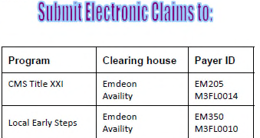
Payer ID’s for Clearinghouse
The Payer ID directs your claim through electronic systems to the correct payer – each clearinghouse will have it’s own Payer ID codes.

Slide 11
What do I need to do?
Step 4 – After February 1st, send your first test claims through the clearinghouse and closely monitor for:
successful submission
payment
If you receive denials, you may need to work with your clearinghouse to refine your configuration for claims submission.

Slide 12
Help!
What if I don’t know how to do medical billing and use a clearinghouse?
Most clearinghouse companies offer training to help you learn how to file claims. Check the web site of the clearinghouse you selected for training options.
You may wish to consider hiring a qualified medical biller who is familiar with this kind of process.

Slide 13
Can I bill on paper?
Paper claims can be submitted on HCFA 1500 Forms, but this will significantly delay your payments.
HCFA 1500 forms are standard medical billing forms. They require precise completion using proper coding systems.
Note: claims that require attachment of an EOB must be filed as a paper claim, even if you normally file electronic claims.

Slide 14
Billing on Paper…
Submit your paper claims on CMS 1500 forms to:
Early Steps claims:
MED 3000 CMS Early Steps
PO Box 981626
El Paso, TX 79998-1626
Title XXI claims:
MED 3000 CMS Title XXI
PO Box 981733
El Paso, TX 79998-1733
CMS1500 Sample for Early Steps.pdf

Slide 15
How will I get paid?
“Clean” electronic claims are generally paid within 10 days to two weeks.
Checks: You will receive paper checks if you don’t set up electronic payment with the State.
Electronic Payment: To receive electronic payment you must enroll in ePayment with Emdeon. This can be done any time – it does not need to be done immediately.
Emdeon ePayment Enrollment.pdf

Slide 16
Is anything still billed to Easter Seals?
Yes – Services funded by Children’s Services Council of Palm Beach County or St. Lucie County will continue to be billed to Easter Seals just as you have been billing.
Generally, these services are:
Consultations (For Palm Beach County or St. Lucie County children)
Travel (For Palm Beach County or St. Lucie County children)
These services will be identified on Form G of the child’s IFSP as CSC funded using the code “COMA”

Slide 17
Special Reminder!
Easter Seals Florida Headquarters Office has moved. Billing (For services prior to 2/1/14 or for PBC or SLC CSC funded services) MUST be mailed to:
Easter Seals Florida, Inc.
Attn: TCES Provider Billing Team
520 N. Semoran Blvd., Suite 280
Orlando, FL 32807

Slide 18
Other Codes and Information
“MMI” is the unique identifier for each child. It can be found on each page of the IFSP at the top. It is used on medical claims (paper and electronic) in the space where you are asked for the “insured’s ID number”.
Taxonomy Codes identify the service you provided.
Taxonomy Code Table for Early Steps Services.pdf

Slide 19
What about services provided before 2/1?
You should continue to send any final invoices for services provided before February 1st, 2014 to Easter Seals Florida. Services should continue to be billed monthly just as you are currently billing.

Slide 20
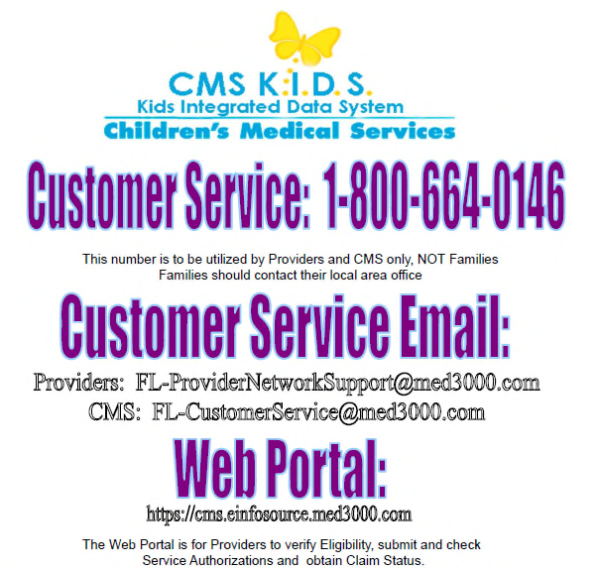
What if I need help?

Slide 21
Your Easter Seals Florida Contacts
Joan Stolzar (Orlando): Contracting
407-306-9766 x 11101
Beverly Carmody (Port St. Lucie): Enrollment
772-380-9973
Debbie Rice (Orlando): Provider Billing Lead
407-306-9766 x 11127
Sasha Tuazon (Orlando): Provider Billing
407-306-9766 x 11128
Please note, while we will help and support you through this change as much as possible, we are not able to conduct medical billing training for providers.

Slide 22
Thank you
While we know that change can be disruptive to your daily work flow, we hope that ultimately you will find CMS K.I.D.S to be a positive change for your practice.

